Slide 1


BalanceIQ
Presented by
Abhinav Sharma
Kiruthickranjan K S

Slide 2






Agenda Overview
Introduction
Existing Problem
Our Solution
Key Features
Project Architecture
Conclusion

Slide 3

Revolutionizing Fitness
Maintaining a healthy lifestyle is challenging in today's fast-paced world. Achieving well-being requires integrating health, diet, and mental goals.
Providing individuals the tools, resources, and support to take charge of their wellness is crucial. An innovative, user-friendly platform can empower users to track progress, access personalized recommendations, and stay motivated.

Slide 4
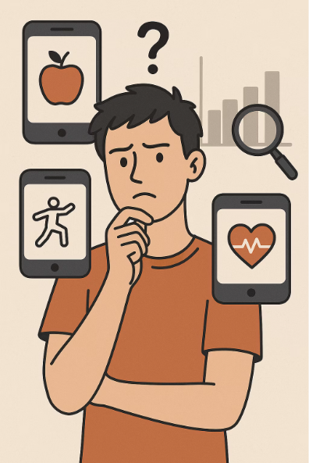
Existing Problem : Isolated Health Tools
Single-Focus Health Apps:
Most health apps concentrate on a single domain—whether diet, exercise, or mental well-being—rather than providing an integrated, holistic view of overall health.
Lack of Insights:
Without personalized analytics and guidance, users struggle to spot trends and make data-driven decisions about their health.

Slide 5

Our Comprehensive Solution
1
Integrated Holistic View
2
Public APIs
3
User Interface
Advanced analytics for data insights
Easy tracking and seamless data entry
Diet, exercise, and mental health combined

Slide 6
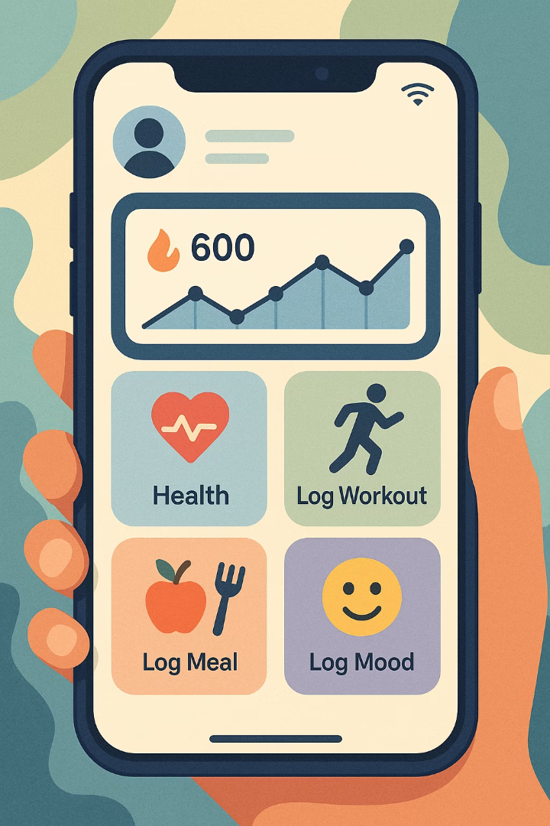
Key Features: User & Admin Management
User Dashboard
Admin Controls
Personalized tracking of Health metrics, Log Workouts, Log Meals, Log Mood
Data management and platform oversight
Calories Burned Tracking
Automatic Calorie Burn Calculation using API

Slide 7
Fitness & Mental Health Insights
Fitness Analytics
Mental Wellness
Workout logging
Mood monitoring
Progress tracking
Meditation Dashboard
Actionable fitness insights

Slide 8





Seamless User Workflow
Register & Profile Setup
Users register and set-uo personal profiles
Activity Logging
Log dietary entries, Physcial Activity entries and Mood
Auto Calorie Burn Calculation
System automatically calculates the Calories Burned based on the type of the activity and duration of the workout
Dashboard Access
Access the Dasboard to maintain the physical and the mental Health of the User
API-driven Analysis
Enhanced data insights

Slide 9
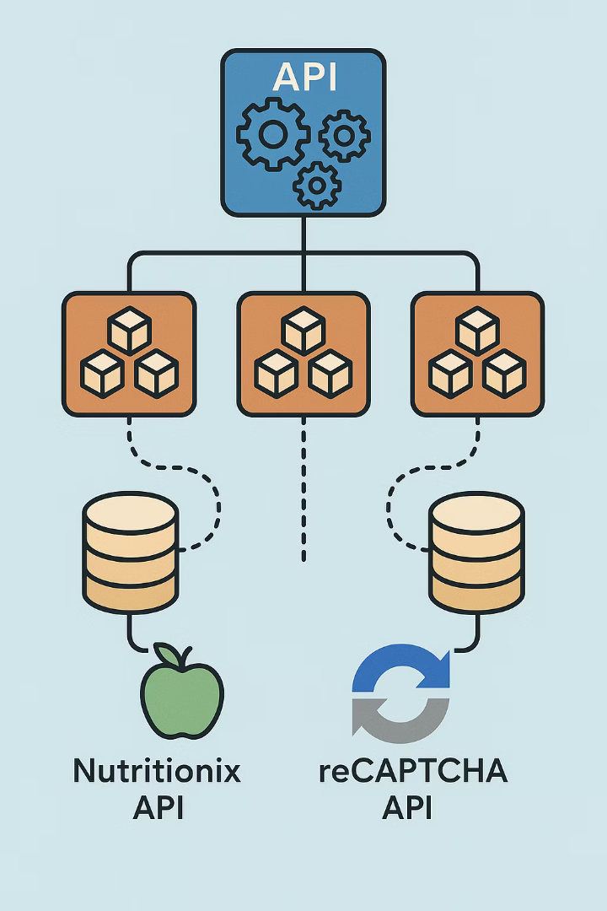

Project Architecture
Dedicated databases back each service—User Profile Management, Health Metrics, Diet, Exercise, and Mental Health—to ensure independent scaling.
Centralizes all service requests and enforces security, routing traffic between clients and microservices.
Leverages the Nutritionix API for nutrition data and Google reCAPTCHA for bot protection.

Slide 10
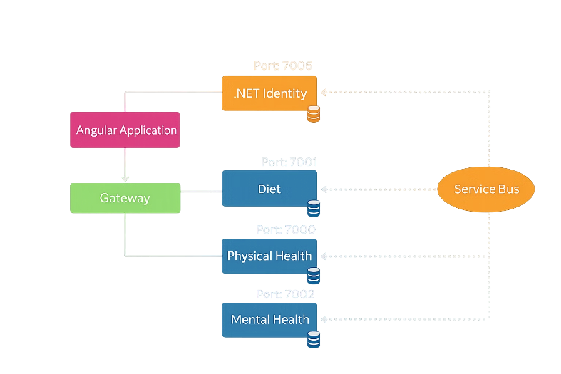
System Architecture

Slide 11
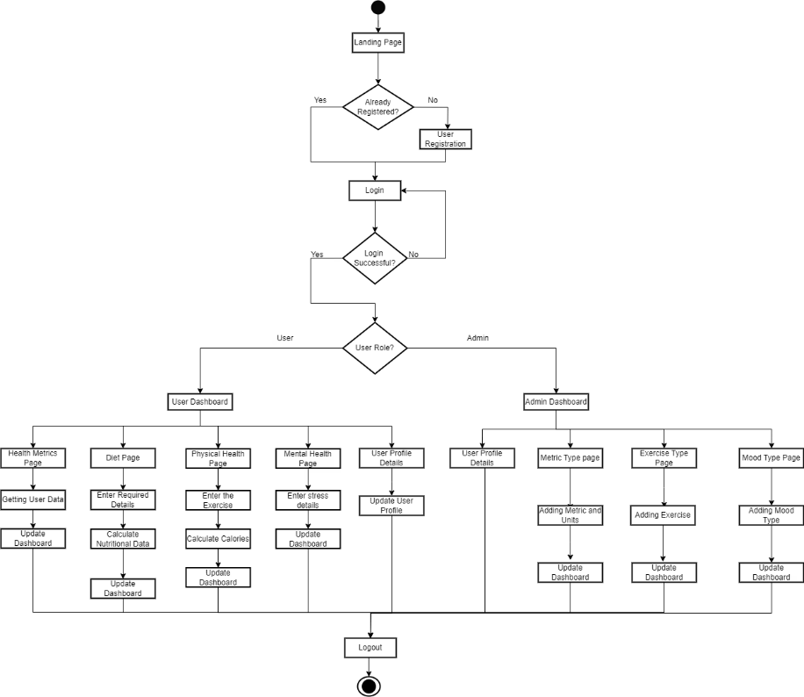
Flow Chart

Slide 12

Technology Stack Overview
Backend
.NET Core (Web API), Entity Framework Core
Frontend
Angular, Toastr notifications
Database
SQL Server

Slide 13
Conclusion
BalanceIQ empowers users to seamlessly track and enhance their physical, mental, and nutritional health.
An intuitive interface delivers personalized insights to guide each individual’s wellness journey.
Built on a scalable foundation, it provides a comprehensive solution for achieving a healthier, more balanced lifestyle.

Slide 14
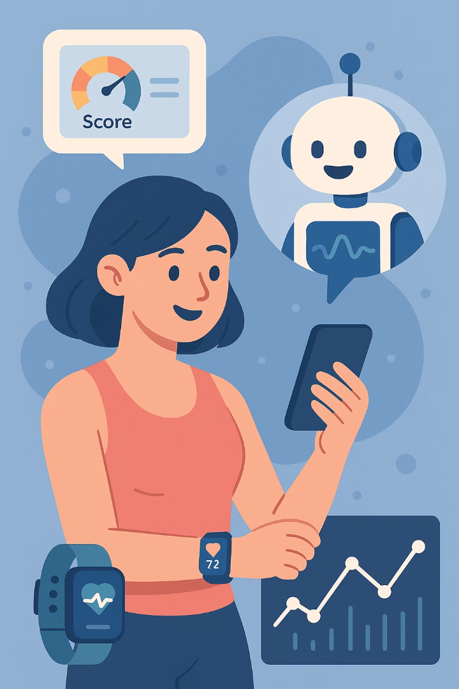
Future Enhancements
Provide a user focused recommendation AI Powerd Chatbot
Using an Algorithm that gives Holistic score to the user as feedback
Utilize fitness devices to automatically collect data instead of relying on manual entries

Slide 15
Thank You

